Slide 1
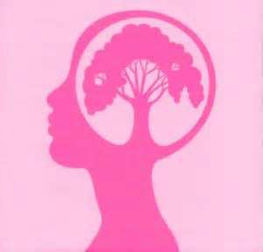
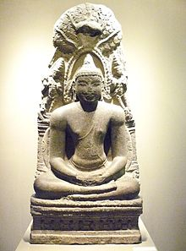
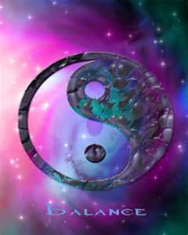
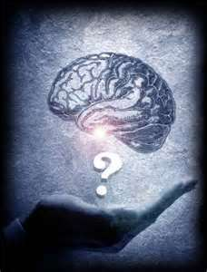
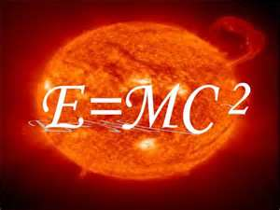
科学 和 佛教 Science and Buddhism
有意思 (并联) 之间: 心理学, 生理学
理论物理学 和 佛教, 道教 哲学
Interesting parallels between psychology, physiology and theoretical physics, and the philosophies of Buddhism and Taoism

Slide 2
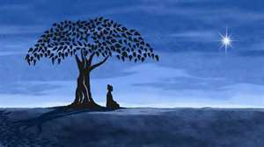
禅佛教 …汉语
Chan Buddhism, called (叫做) “Zen” in the west (西洋) was - in about the 6th Century in China - the last major branch of Buddhism to evolve.

Slide 3
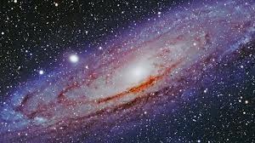
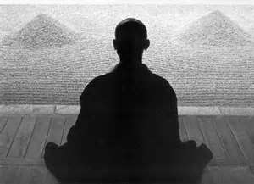
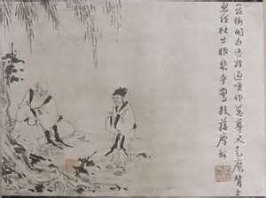
汉语 Chan is about:
汉语
The attainment of enlightenment via direct insight into Buddhist teachings & is not so much about sutras, but focusing on Zuòchán – deep meditation.

Slide 4
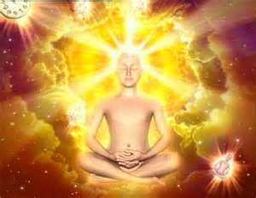
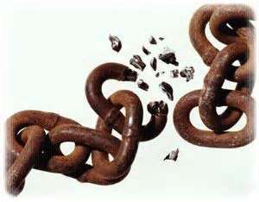
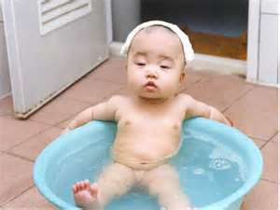
坐禅 Zuòchán – deep meditation
汉语
involves relaxing the body and mind totally, breaking the chains of logic that trap us in our everyday mind and so allowing us to see, hear and feel reality simply, clearly and directly.

Slide 5
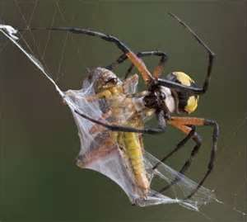
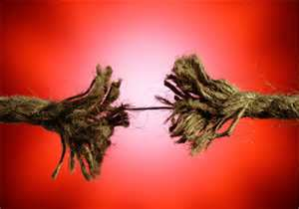
我们 现代的 人… We modern humans…
存在 身陷 在 因素律条件 的 虎口
Are trapped in webs of causality…
汉语
If this → then that!!! … that’s logic.
汉语
Sometimes it’s very useful, but sometimes it kills us with stress…

Slide 6
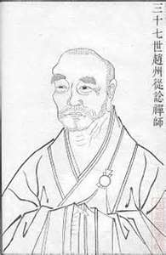
公案 (gōng‘àn/Koan) 和 曼特拉 (Màntèlā/Mantra)
汉语
…are two ways to stop the logic at least for a while.
汉语
A monk (和尚) once asked Tang Dynasty (大唐) Chan 禅 Master Zhaozhou Congshen (赵州禅师 778-897): “Does a dog have Buddha nature?” (狗会有佛性?) Zhaozhou replied (回答) “No.” (無門關)
汉语
This stops the mind because it directly contradicts the Mahayana belief that all things have the Buddha nature.

Slide 7
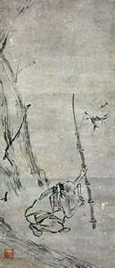
汉语…
Two monks were watching a flag flapping in the wind. One said to the other, "The flag is moving.“ The other replied, "The wind is moving."Huineng overheard this. He said, "Not the flag, not the wind; mind is moving."

Slide 8
汉语 But,和 公案 (gōng'àn/Koan) are more than paradoxical nonsense…
汉语
Calling the writings of Chan master “public cases” (gong an) started during the Tang Dynasty and became popular during the Song Dynasty. They are in one way an expression of official documents of secular law. When facing a wall (in meditation) it is the zero point. The perceptive master tests for this with scolding, shouting and even blows to see the real extent of attainment, like an old magistrate testing evidence.

Slide 9
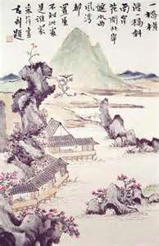
汉语 Another example of the legal metaphor…
In the Evening talks in a Mountain Hut (Shanfang Yehua) by Zhongfeng Mingben (1263-1323) it says:
“Someone asked, “why is it that the devices and encounters of the Buddha and patriarchs are commonly called public cases (gong’an)? Huan (Zhongfeng) replied: “Public cases” are likened to case documents of the public court (gongfu zhi andu). They embody the law, and thus the control of disorder through the Kingly Way truly depends on them. “Public (gong) refers to the ultimate principle (li) by which the sages unify the wheel ruts and standardize the roads through the empire. “Cases (an) are the authoritative writings recording the principles set forth by the sages. ..”
山房 夜话… 汉语…
Reference: http://114.64.255.26/buddhiststudies.berkeley.edu/people/faculty/sharf/documents/Sharf%202007%20Chan%20Gongan.pdf?y=yjwt08

Slide 10
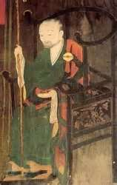
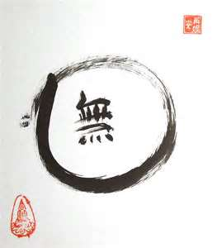
汉语
Dahui Zonggao (1089–1163) introduced the use of k'an-hua, "observing the phrase". In this practice students were to observe (k'an) or concentrate on a single word or phrase (hua-t'ou), such as the famous Wu (无) .

Slide 11
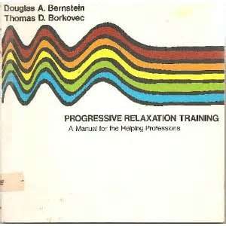
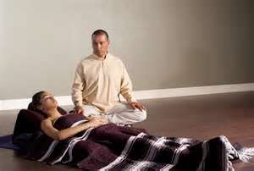
汉语 Modern Scientists are discovering…
汉语
汉语
These same things and teaching relaxation response (松弛技术 ) and relaxation therapy (松弛疗法 ).
They also use guided imagery (引导性想象治疗 [yǐn dǎo xìng xiǎng xiàng zhì liáo) and slow breathing techniques.
For more information on these subjects check out: http://noetic.org/

Slide 12
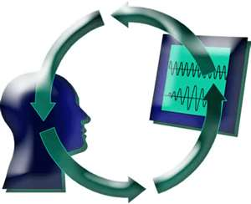
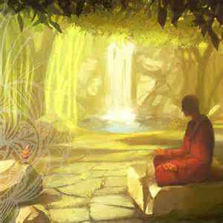
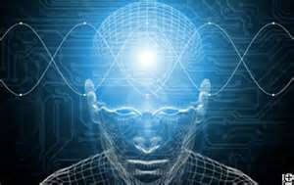
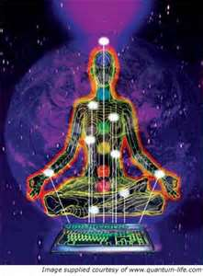
汉语 Many if not most diseases are stress related.
汉语
汉语
Too much stress weakens the immune system, opening the doors to disease.
To learn relaxation response 松弛技术 sōng chí jì shù people have to break the chains of everyday thought – much the same as ancient Chan masters taught, only now they sometimes use some different techniques including biofeedback生物反馈.

Slide 13
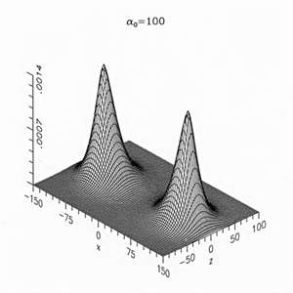
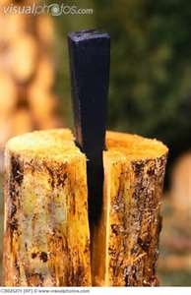
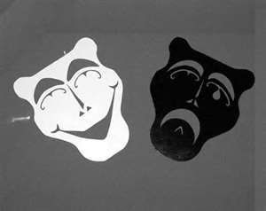
From a systems analysis 系统分析view
汉语
As babies we learn words that chop up the world into this and that, up and down, good and bad. These dichotomies (一分为二) divide our worlds and we live the rest of our lives in these webs/chains of logic with a split mind.

Slide 14
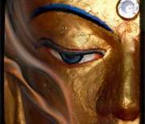
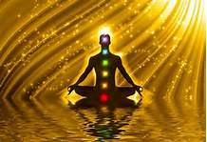
汉语
汉语
A psychologist named George Kelly in the 1950s presented a theory that human learning is made of “constructs,” polar opposites, like “happy” and “sad,” and we all put people at either extreme or in between, and that people learn anticipation and prediction as babies to control others, like: “If I cry, my mother will come.”
One of the stages leading to the Buddha’s great enlightenment was realizing the illusory nature of dualities. Kelly was right… people learn (create) these dualities and we project them on the universe. There are not really there except as people make them and believe in them. Letting go of them is a necessary stage to experience of enlightenment.

Slide 15
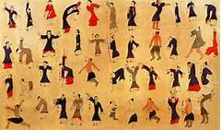
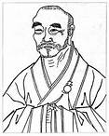
Zuòchán – deep meditation
汉语
Helps us unlearn all that and re-integrate the universe into oneness using 公案 (gōng‘àn/Koan) 和 曼特拉 (Màntèlā/Mantra) . We can also try relaxation response training 松弛技术 sōng chí jì shù, relaxation therapy 松弛疗法 sōng chí liáo fǎ, guided imagery (引导性想象治疗 [yǐn dǎo xìng xiǎng xiàng zhì liáo) and/or slow breathing techniques like in 导引.

Slide 16
1) 修心养性性
to cultivate one's original nature and improve one’s self
2) 返璞归真/“归真返璞”
recover one's original purity and simplicity; get back to nature
汉语…
involve unlearning much of what we learned as babies and young children.

Slide 17
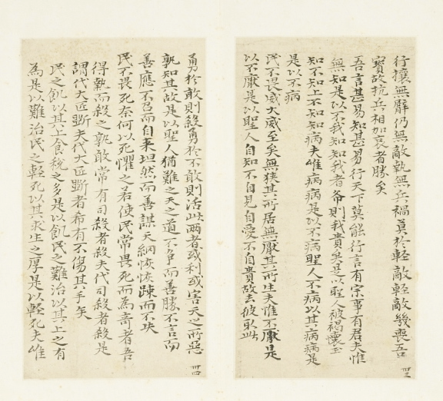
汉语 “The way that can be spoken of is not the true way.” (道德经)

Slide 18
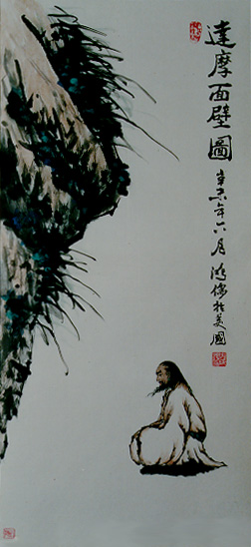
汉语
Transcending (超现实) or unifying (合而为一) dichotomies like “up and down,” “good and bad,” “this and that”… sounds not so difficult. Even letting go of the tyrant of “self” and becoming one with all (天人合一) seems not so impossible. But, how does one transcend “being and non-being (存在 和 不存在)?”

Slide 19
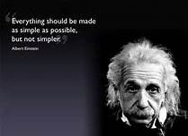
爱因斯坦…汉语
汉语
Einstein wrote that time = space, they are both the relationship between objects in motion. He helped us transcend/unify time and space.
He also realized that ALL things are energy. --> E=MC²

Slide 20
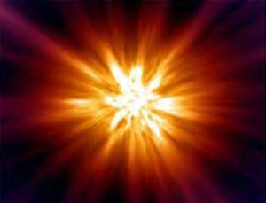
但是 存在 和 不存在? But, being and non-being?
汉语
汉语
Scientists believe the universe started with a “Big Bang” about 13.77 billion years ago.
And, some scientists believe that in trillions of years the universe will burn out, and everything will be dark again.

Slide 21
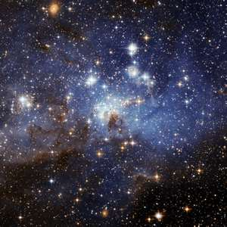
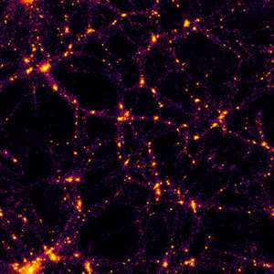
白衣苍狗 - 無 常 Impermanence
Chinese here
This birth and death of the universe supports the Buddhist belief in the impermanence of all things. We are born, grow, decay and die. This is the natural cycle of all things.

Slide 22
汉语… Some scientists believe in…
脉动 宇宙 理论…
The Pulsating Universe Theory… there is a big bang, eventually the universe burns out, then there’s another big bang. Happening very quickly this looks like a pulsating light off/on/off/on - darkness/light/darkness/light - forever.

Slide 23
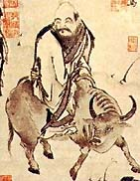
汉语… “Darkness within darkness the gateway to all mystery.” (道德经)

Slide 24
汉语
汉语
汉语
A mathematician named Elihu Lubkin used math to prove that in reality, time and space are only created by humans and all the past, present and future universes are happening at the same time.
He called this the “Simultaneously Coexisting Universes Theory.”
This writer is no expert on Chan Buddhism, but this sounds like Transcending (超现实) or unifying (合而为一) being (存在) and non-being 不存在 to me.

Slide 25
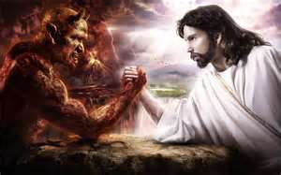
汉语… Some mistakes… maybe
汉语
汉语
汉语
汉语
汉语
I don’t think the Buddha wanted to be worshipped (盲目崇拜) like a God.
Jewish, Christians and Muslims believe in God.
I don’t think Buddha “wanted” to be compared to a God.
I don’t thing the opposite of Buddha is “Devil.”
I think the God/Devil dichotomy is something Buddhists have to transcend/unify to attain enlightenment.
佛教
(依我拙见)
In my humble opinion

Slide 26
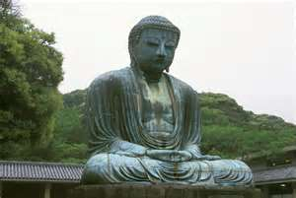
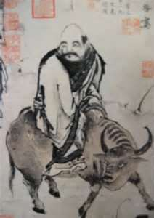
禅佛教 和道教 Chan Buddhism and Daoism…
汉语…
I personally think Daoism influenced the evolution of Chan Buddhism in China. Both are very direct paths to enlightenment. They are very different (Daoists believe in “luck,” Buddhists don’t, they believe in Cause and Effect, and Karma – even through different lifetimes), and yet Daoism and Buddhism are similar in many ways too, in my humble opinion.

Slide 27
汉语 About science…
汉语
汉语
汉语
汉语
世界和平
I don’t worship science either.
I think our scientists know less than half of what there is to know about the universe.
I think our scientists know only 5% of humans true potential.
I think Buddhism and Daoism are helpful to promote health, happiness, enlightenment and world peace.

Slide 28
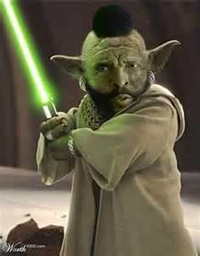
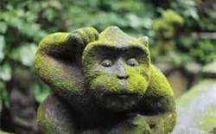
最后 Finally
汉语
汉语
汉语
I am no expert on Buddhism or Daoism; no master or teacher.
Everything I wrote here may be wrong.
Find a true master and good luck!
www.fightingartsasia.com

Slide 29
和…谢谢! And, Thanks!
To my good friend “Shifu” for his valuable teaching and help.

